Slide 1
SMART LIGHTING

Slide 2
INTRODUCTION
Smart lighting systems is used to save energy by adjusting lighting based on ambient conditions, such as switching on/off the light when needed.
Modes: Auto, Manual
Auto Mode: Senses light level in the room periodically using ldr sensor and based on the light level, it turns the light on/off .
Manual Mode: In this mode, user manually turns the switch on/off to control the light. Based on the switch state, the light either turns on or turns off .

Slide 3
Components Used: ESP 32 Wifi Module, LDR Sensor, Resistor, LED, Switch
Software: Arduino IDE
Language Used: Embedded C
DataBase: Firebase
App FrameWork: Blynk App, MIT Inventor App, Streamlit WebApp

Slide 4
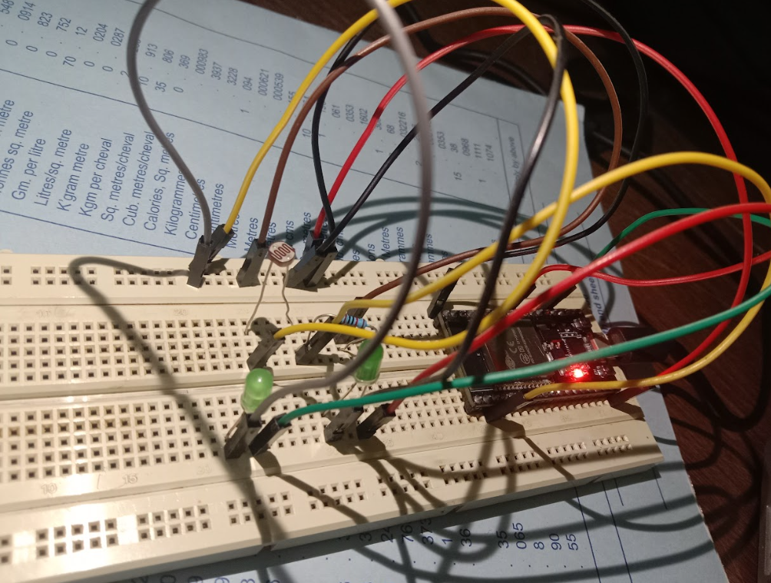
Hardware Setup

Slide 5
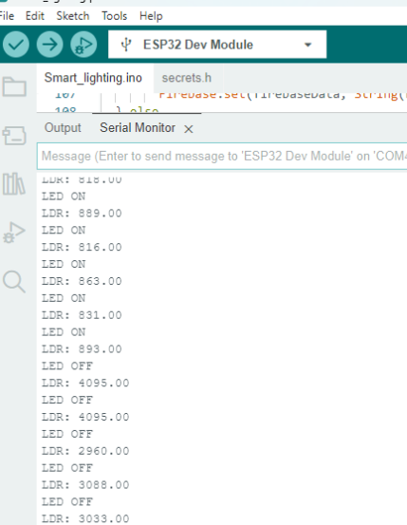
Arduino IDE - Serial Monitor

Slide 6
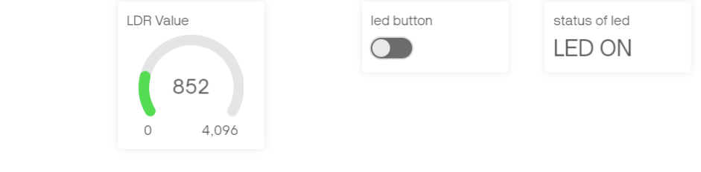
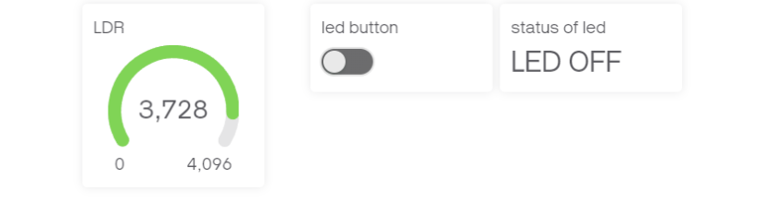
Blynk Dashboard
Auto Mode:

Slide 7
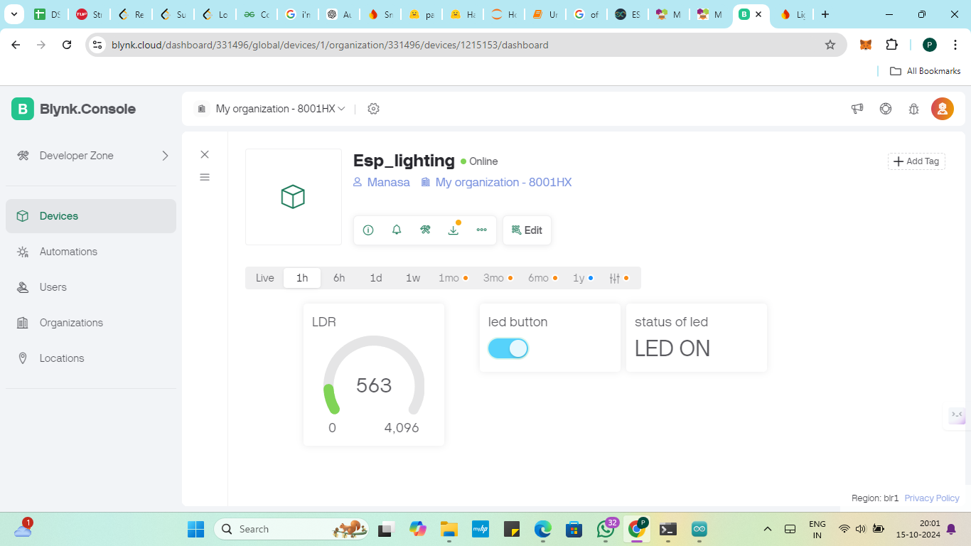
Blynk Dashboard
Manual Mode:

Slide 8
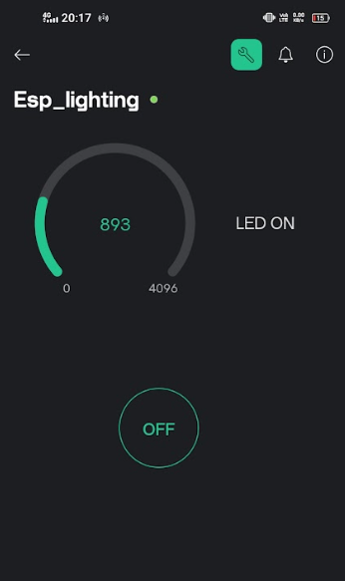
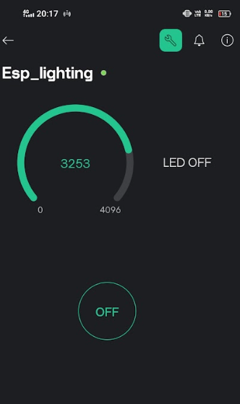
Blynk App

Slide 9
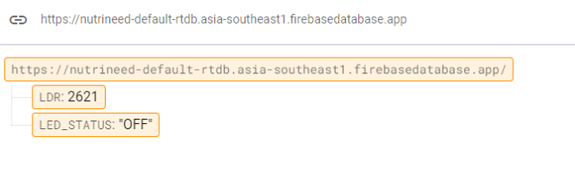
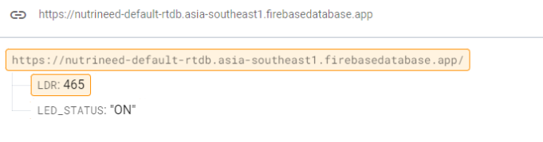
Firebase Database

Slide 10
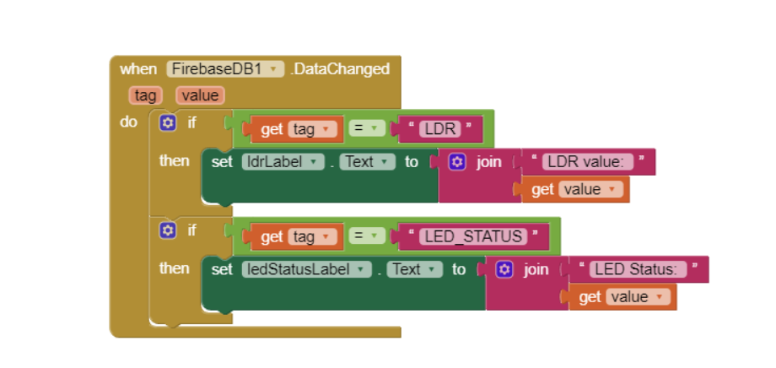
MIT Inventor App

Slide 11
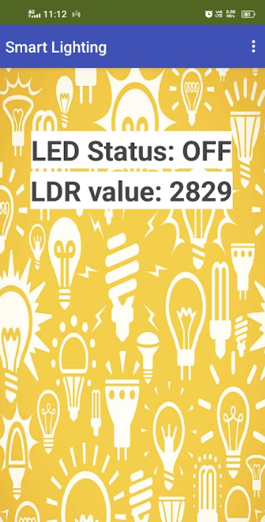
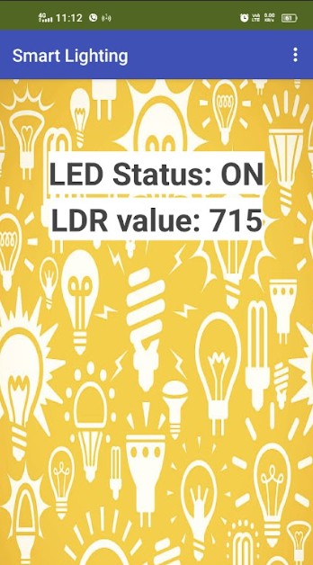
MIT Inventor App

Slide 12
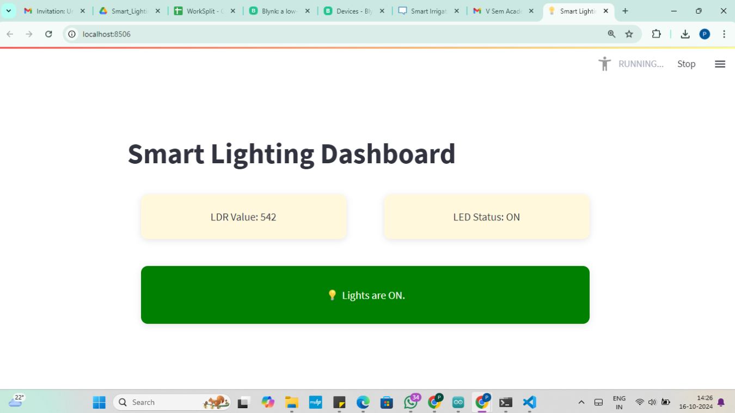
Streamlit WebApp

Slide 13
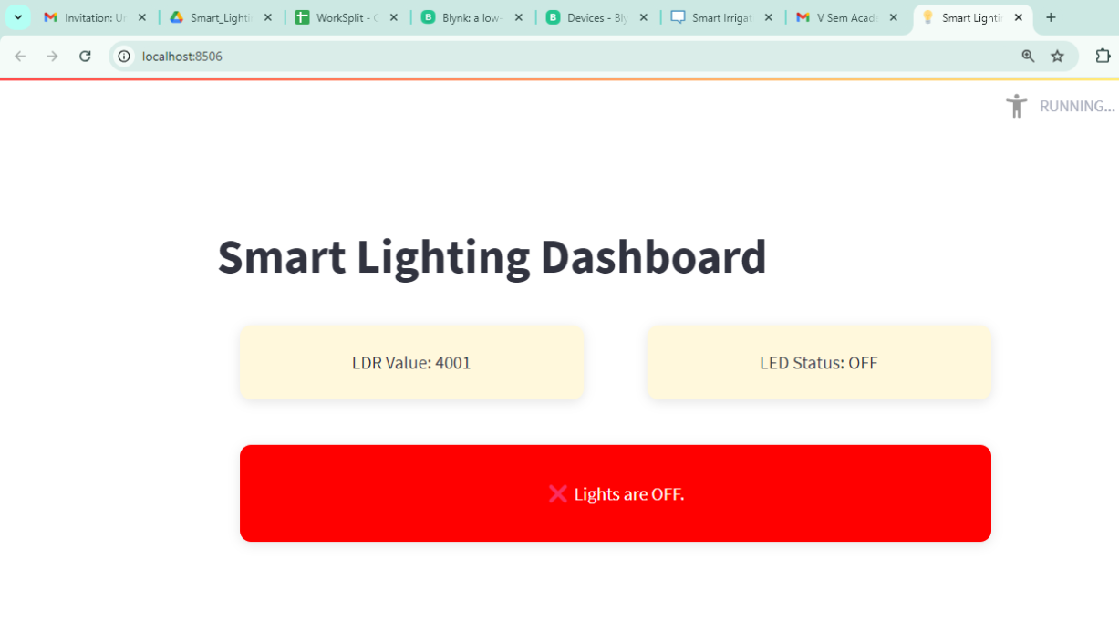
Streamlit WebApp

Slide 14
VIDEO LINK
https://drive.google.com/file/d/1sWmPeGfkRm8GVZCelDI9Q7Y8ixoyCvo8/view?usp=drive_link

Slide 15
APPLICATIONS
Energy-efficient homes: Smart lighting systems in homes adjust brightness or turn lights off based on occupancy and natural light levels, reducing energy consumption.
Smart cities: Streetlights equipped with sensors can automatically dim or brighten based on traffic or pedestrian activity, enhancing safety while saving energy.
Workplaces: Offices use smart lighting to adjust brightness based on the time of day or employee presence, improving productivity and reducing energy costs.
Retail: Stores use smart lighting to highlight products dynamically, creating engaging environments that can be controlled remotely based on customer flow and preferences.

Slide 16
THANK YOU

